Slide 1
Page Replacement Policy
P. K. Roy
Asst. Professor
Siliguri Institute of Technology

Slide 2
Major Concern (1)
Memory Capacity: Limited
Page Fault: The page fault rate must not increase with an increase in the memory allocation in a program.
Demand Paging: What actually happens when a page fault occurs?
Locality of Reference: The replacement policy must not remove a page which may be referenced in the immediate future.

Slide 3
Major Concern (2)
Page Reference String: Sequence of page numbers, arranged in chronological order in which the pages are referenced during execution.
Logical Timestamp: Advanced only when the program is in running state.
Page Reference String
1 | 1 | 2 | 1 | 1 | 1 | 3 | 1 | 3 | 1
t₀ | t₁ | t₂ | t₃ | t₄ | t₅ | t₆ | t₇ | t₈ | t₉
Reference Time String

Slide 4
Functions Involved
Which page is to be removed from the memory.
Page-out(Swap-out) operation
Page-in(Swap-in) operation

Slide 5
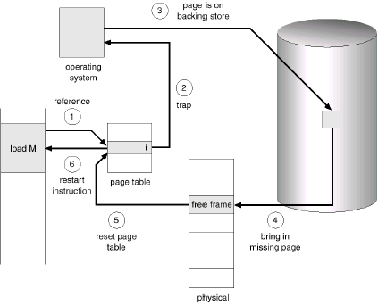
Handling Page Fault (1)

Slide 6
Handling Page Fault (2)
1- Check whether the reference page was valid or in invalid memory access.
2- If the reference was invalid, the process terminated.
3- The operating system will find a free frame (by taking one from the free frame list, for example).
4- The scheduling a disc operation to read the desired page into the newly allocated frame.
5- The internal table will modify and the page table to indicate that page is now in memory.
6- Restart the instruction that was interrupted by the illegal address trap. The process can now access the page as though it had always been in memory.

Slide 7
Page Replacement Algorithms
1- Find the location of the desired page on the backing store.
2- Find a free frame:
a. If there is a free frame uses it,
b. Otherwise use a page replacement algorithm to select a victim frame
c. Write the victim page to the backing store and change the page and frame tables accordingly.
3- Read the desired page into the free frame changing the page and frame tables
4- Restart the user process
There are many different page replacement algorithms probably every operating system has its own unique replacement scheme. How do we select particular replacement algorithms? In general, we want the one with the lowest page fault rate.

Slide 8
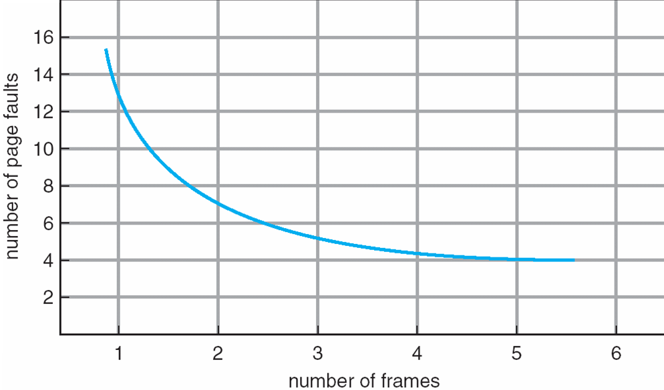
Graph of Page Faults vs. the Number of Frames

Slide 9
Main Page Replacement Algorithms
First In First Out (FIFO)
Optimal (OPT)
Least Recently Used (LRU)

Slide 10
First In First Out (FIFO)
Treats page frames allocated to a process as a circular buffer:
When the buffer is full, the oldest page is replaced. Hence first-in, first-out:
A frequently used page is often the oldest, so it will be repeatedly paged out by FIFO.
Simple to implement:
requires only a pointer that circles through the page frames of the process.

Slide 11
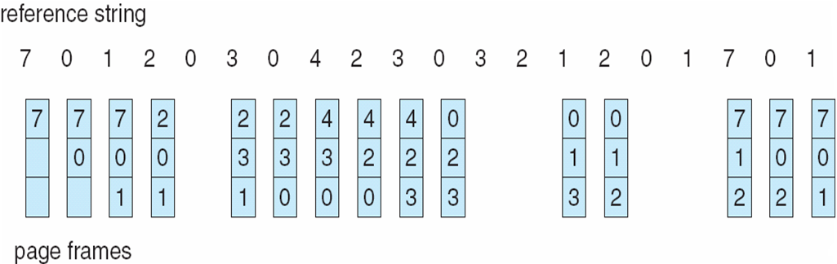
First In First Out (FIFO)

Slide 12
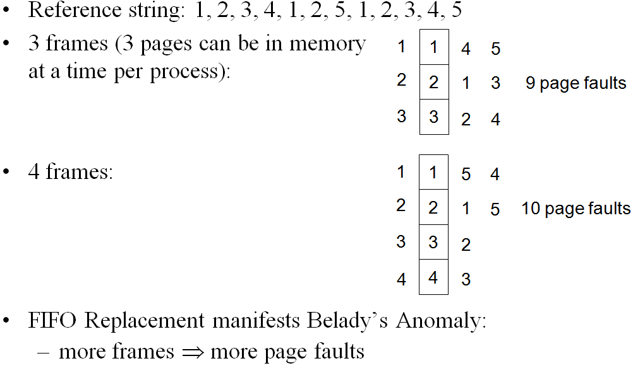
First In First Out (FIFO)

Slide 13
Belady’s Anomaly
In computer storage, Belady's anomaly is the name given to the phenomenon in which increasing the number of page frames results in an increase in the number of page faults for certain memory access patterns.
This phenomenon is commonly experienced when using the First in First Out (FIFO) page replacement algorithm.

Slide 14
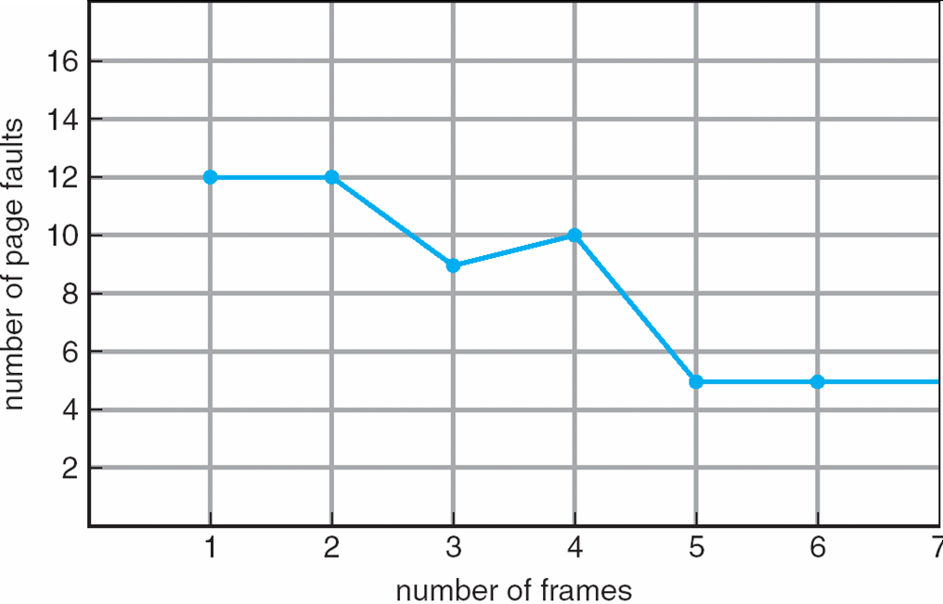
FIFO Illustrating Belady’s Anomaly
This algorithm suffers from Belady's anomaly. The fault rate might actually increase when the algorithm is given more memory.

Slide 15
Optimal Page Replacement
The Optimal policy selects for replacement the page that will not be used for longest period of time.
Has the lowest page fault rate for any page reference stream.
Impossible to implement (need to know the future) but serves as a standard to compare with the other algorithms we shall study.

Slide 16
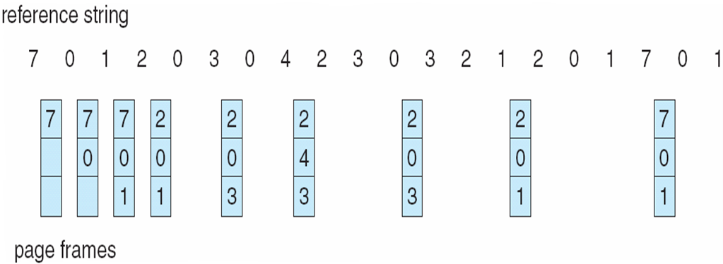
Optimal Page Replacement

Slide 17
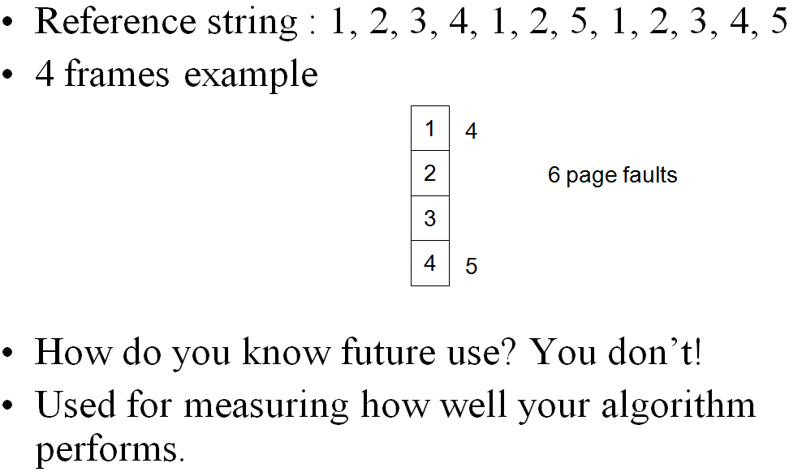
Optimal Page Replacement

Slide 18
The LRU Policy
Replaces the page that has not been referenced for the longest time:
By the principle of locality, this should be the page least likely to be referenced in the near future.
LRU make guess based upon past experience.
chooses that page which has not been used for longest period of time.
each page is associated with the time of its last use.
performs nearly as well as the optimal policy.

Slide 19
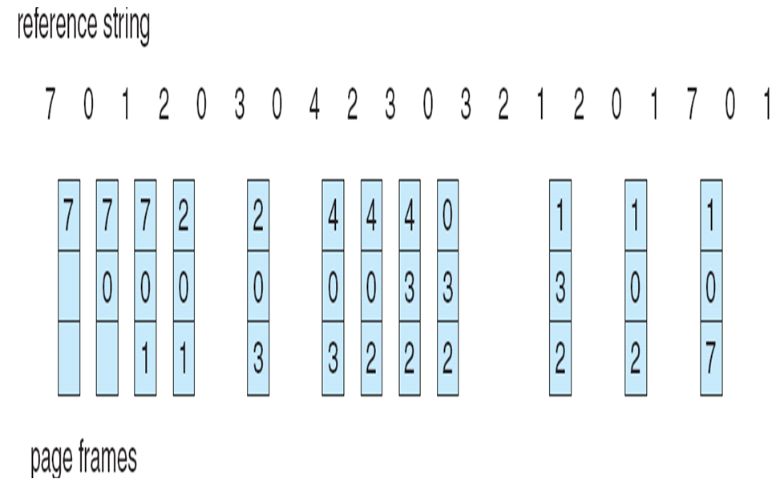
The LRU Policy

Slide 20
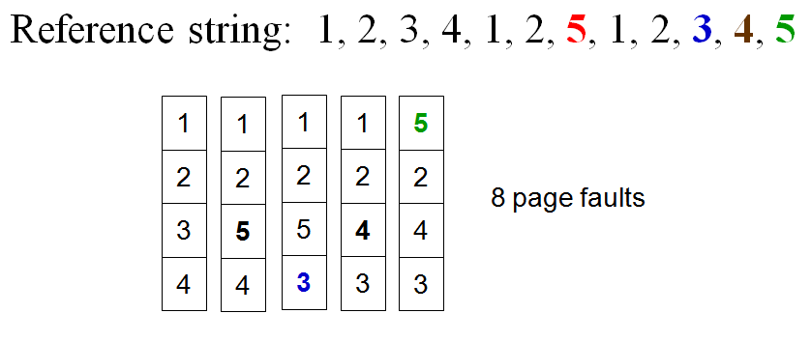
The LRU Policy

Slide 21
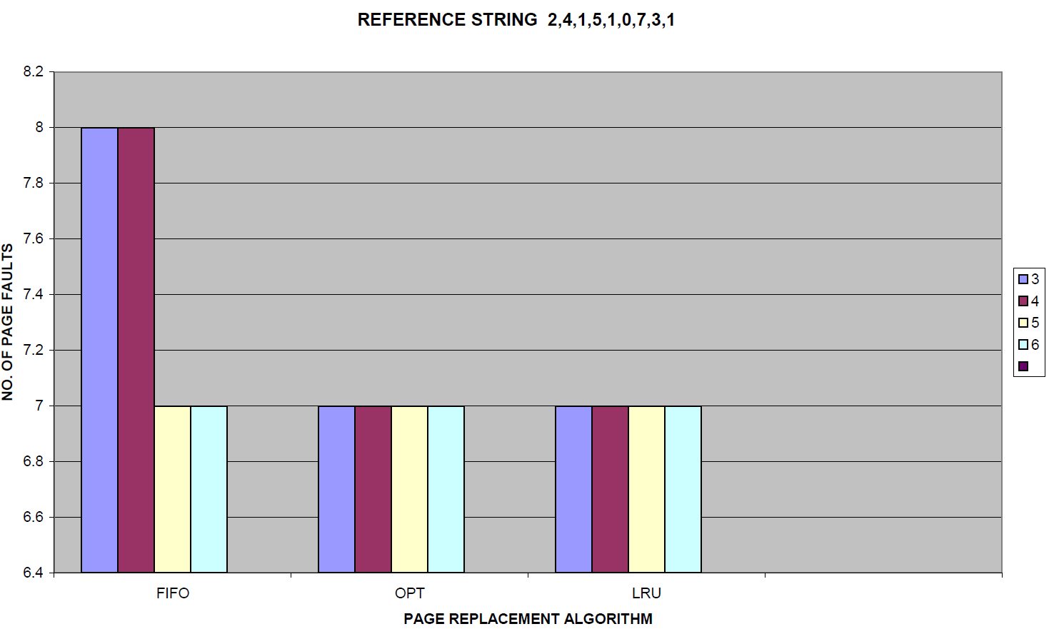
Case Study(1)
length of random reference string is (9)

Slide 22
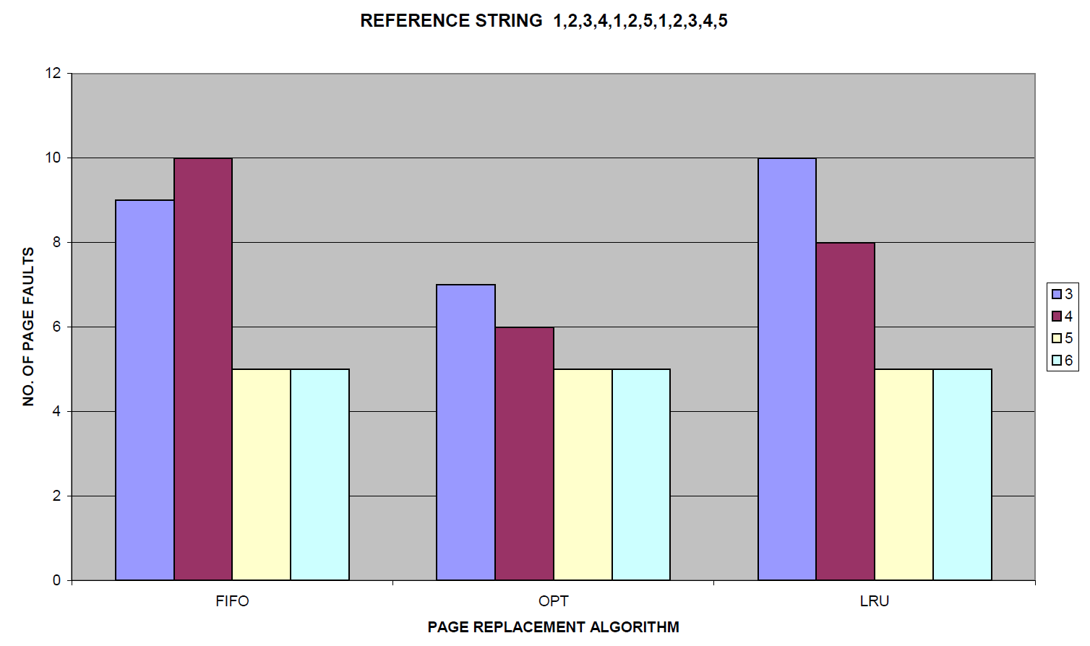
Case Study(2-a)
length of random reference string is (12)

Slide 23
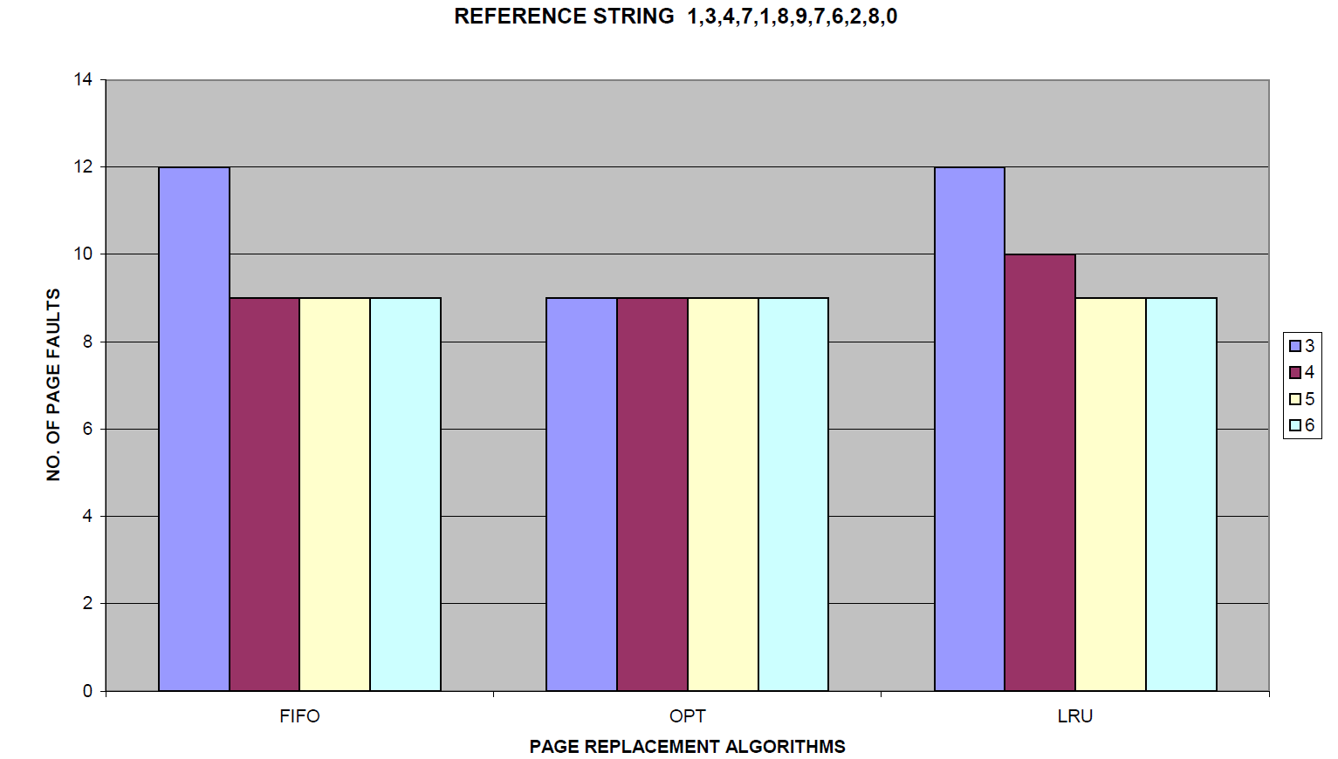
Case Study(2-b)
length of random reference string is (12)

Slide 24
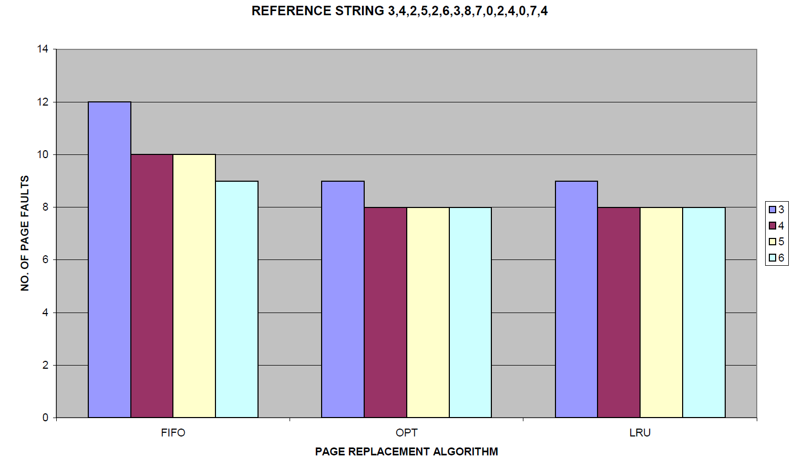
Case Study(3)
length of random reference string is (15)

Slide 25
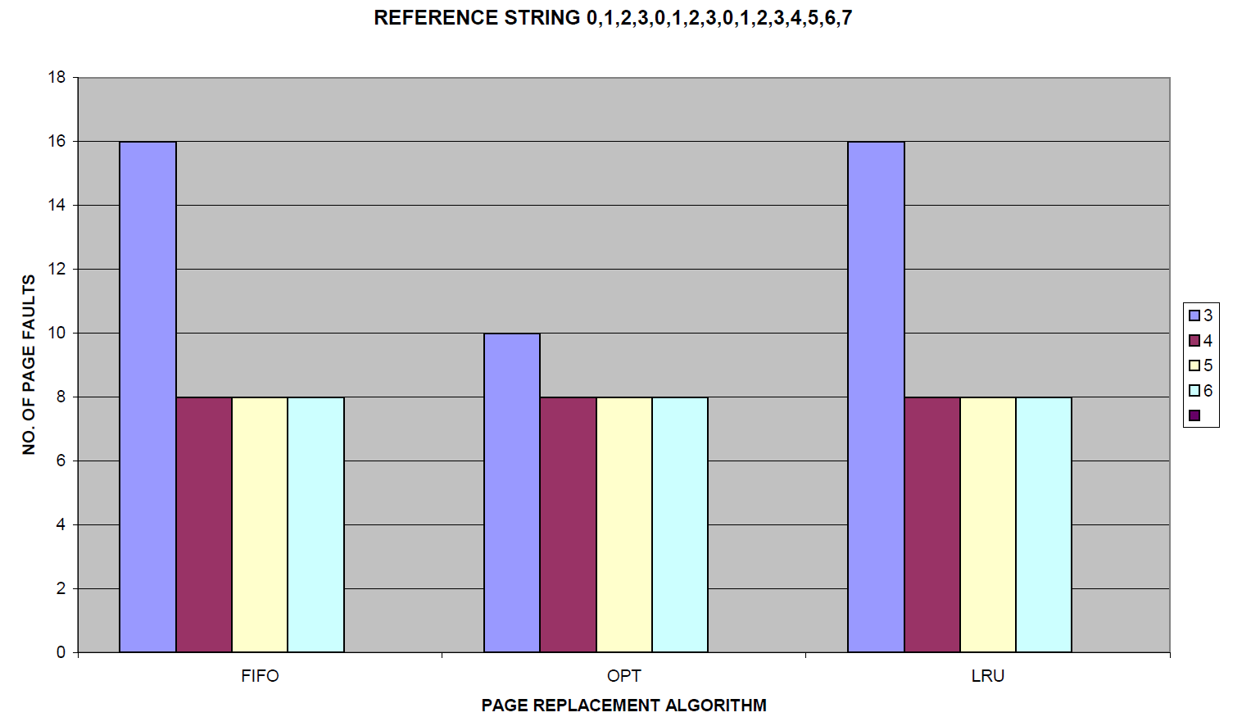
Case Study(4)
length of random reference string is (16)

Slide 26
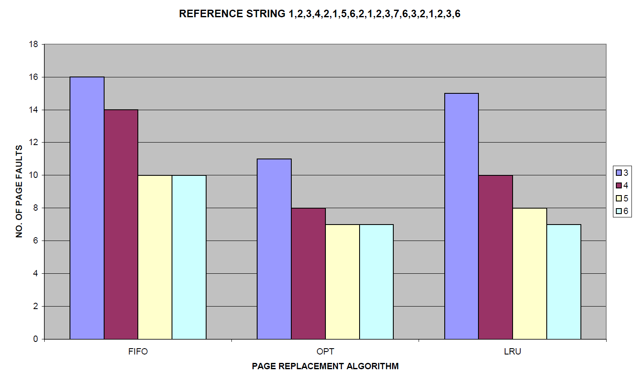
Case Study(5)
length of random reference string is (20)

Slide 27
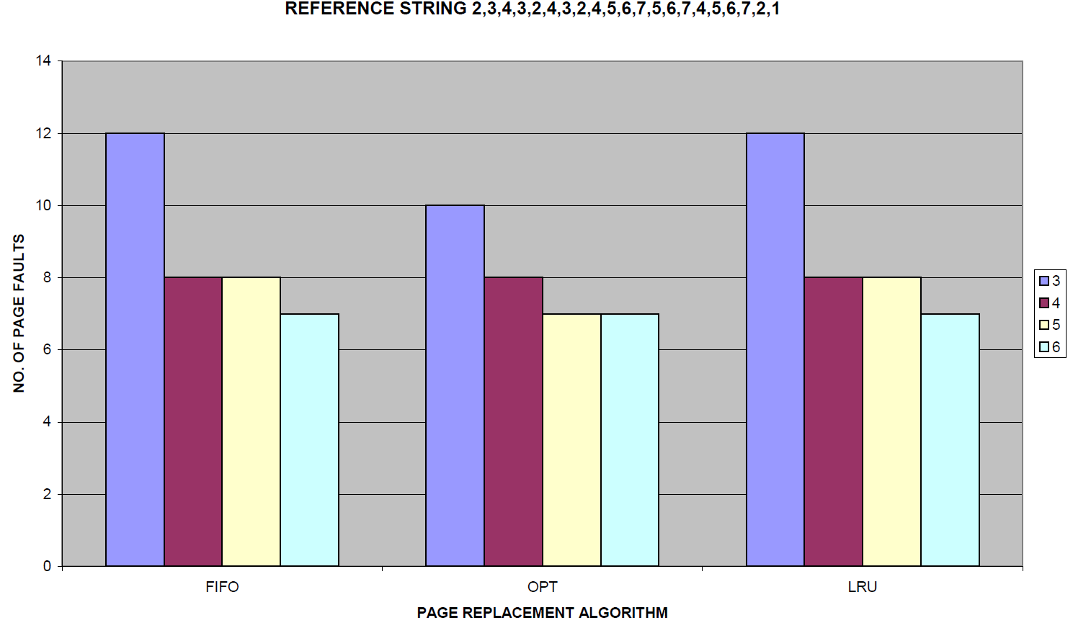
Case Study(6)
length of random reference string is (21)

Slide 28
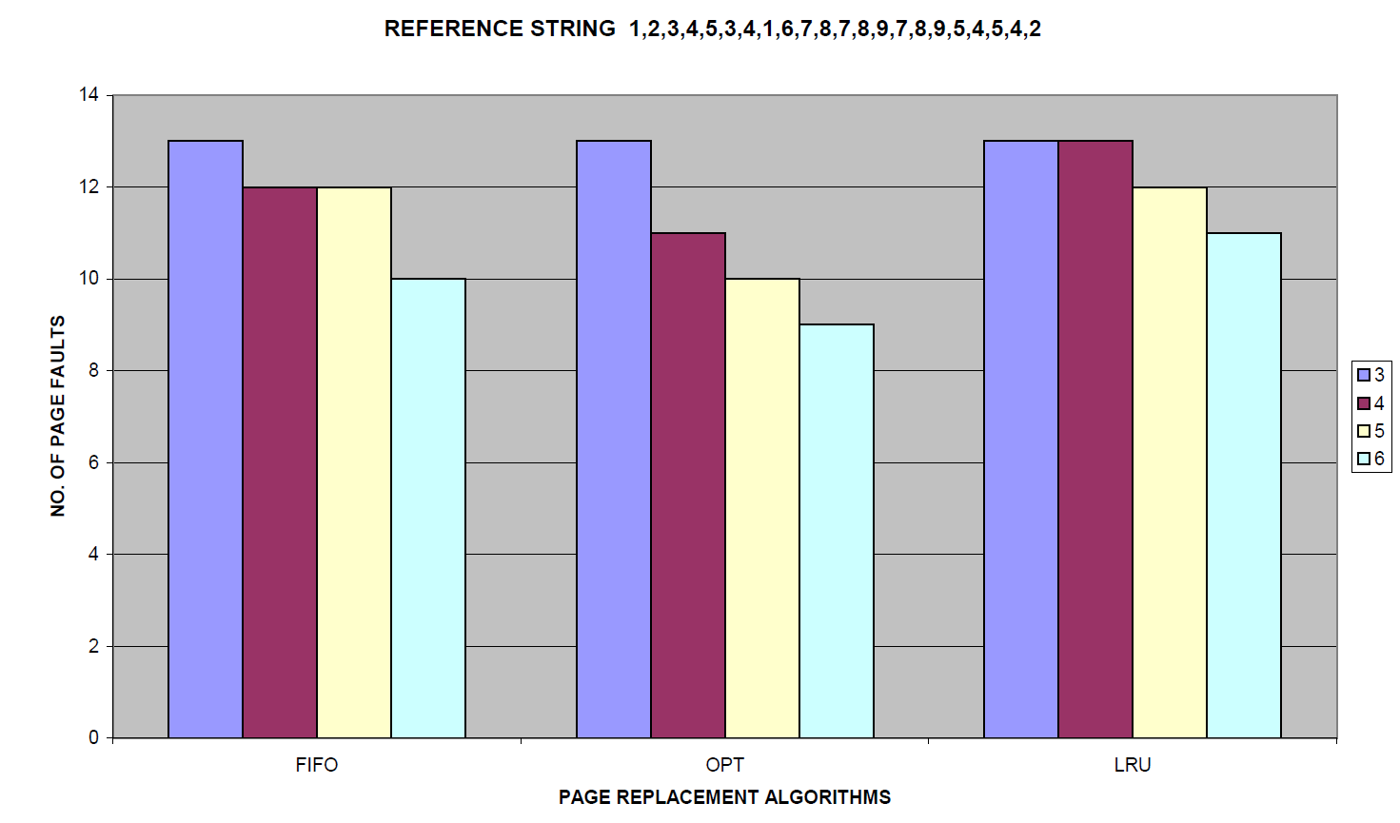
Case Study(7)
length of random reference string is (22)

Slide 29

Conclusion ????

Slide 30

References
System Programming and Operating System: D M Dhamdhere
Modern Operating System: Andrew S. Tanenbaum
Computer Organization & Architecture: T. K. Ghosh
https://www.wikipedia.org

